Slide 1



Presented by:
Noureldin Mostafa Galal
Mona Abdelrhman Mostafa
Farah Aksam Ibrahim
Toka Ramadan Mohamed
Mina Sameh Ibrahim
Mostafa Mortada Mohamed

Slide 2

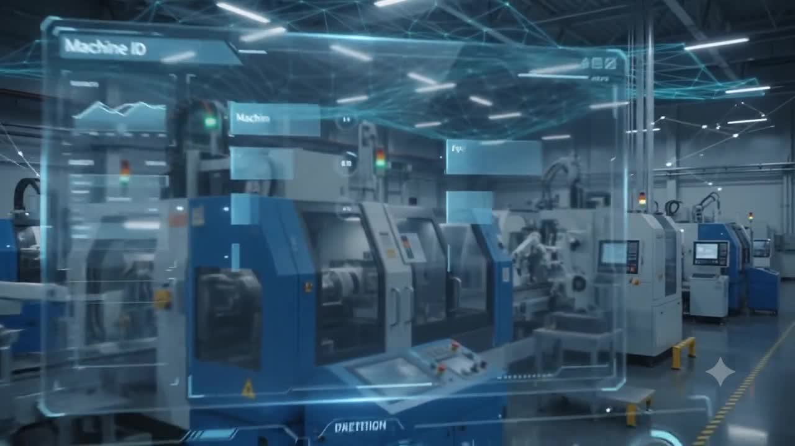

Slide 3



Analyze manufacturing downtime and machine failures.
Identify critical failure indicators.
OUR PROJECT’S
Evaluate machine and assembly line performance.
Detect early warning signs of equipment failure.
OBJECTIVES
Build a machine learning model for failure prediction.
Support predictive maintenance and reduce production interruptions.

Slide 4

EQUIPMENT IDENTIFICATION
Every data point is anchored to a specific machine, location, and time.
MACHINE_ID
Assembly_Line_No
DATE
Makino-L1-Unit1-2013
Makino-L2-Unit2-2014
Makino-L3-Unit3-2015
Shopfloor-L1
Shopfloor-L2
Shopfloor-L3
DD/MM/YY

Slide 5


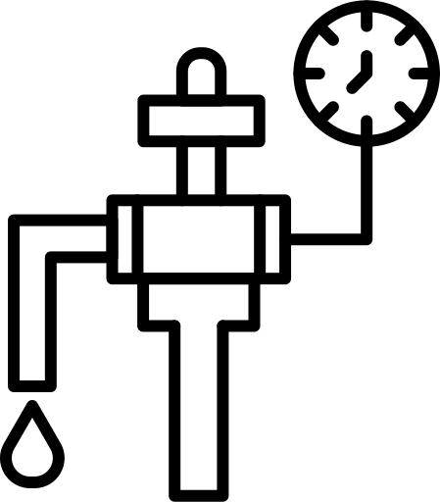

Hydraulic Pressure
Drives primary moving components measured in bar.
FLUID POWER
PRESSURE SYSTEMS
COOLANT PRESUURE
Ensure consistent flow at the tool workpiece interface.
Air System Pressure
The circulatory system of every CNC unit.
Powers tool changes and debris clearing.

Slide 6





Hydraulic Oil Temp(°C)
Viscosity & lubrication integrity.
THERMAL
MONITORING
Coolant Temperature.
Fluid thermal state at cutting zone.
Heat is the enemy of precision.
Thermal drift causes dimensional errors.
Spindle Bearing Temp (°C)
Prevents thermal expansion & accuracy loss.
VIBRATION
Tool Vibration
Oscillation of the cutting tool itself.
DISPLACEMENT TRACKING
Spindle Vibration
Oscillation of the machine spindle assembly.
Mechanical oscillations compromise surface finish and tool life. Measured in micrometers (µm).

Slide 7


KINEMATICS &
ELECTROCHEMICAL
VOLTAGE (V)
Electrical Power Supply
SPINDLE SPEED (RPM)
Rational Frequency
TORQUE (Nm)
Reactive Mechanical Force
CUTTING FORCE (kN)
Materiak Resistance

Slide 8


OPERATIONAL STATUS
Operational
Machine running within nominal tolerances no intervention needed
THE TARGET VARIABLE
Machine Failure
Critical fault or wear threshold reached triggers maintenance protocol
All sensor data converges on one critical classification

Slide 9
DATA PREPROCESSING

Slide 10
DUPLICATE RECORDS CHECK
Checked dataset for duplicate rows
Result: 0 duplicates found
DATE COLUMN CONVERSION
Date column was originally stored in object/string format
Converted Date column to proper datetime format
Handled mixed date formats present in the data
Ensured day-first format interpretation for correct date parsing

Slide 11
MISSING VALUES IDENTIFICATIONS
MISSING VALUES PRESENT ONLY IN NUMERIC/SENSOR COLUMNS. AFFECTED COLUMNS:
HYDRAULIC PRESSURE (BAR) = 10
COOLANT PRESSURE (BAR) = 19
AIR SYSTEM PRESSURE (BAR) = 17
COOLANT TEMPERATURE = 12
VOLTAGE (VOLTS) = 6
TORQUE (NM) = 21
SPINDLE VIBRATION (ΜM) = 11
TOOL VIBRATION (ΜM) = 11
SPINDLE SPEED (RPM) = 6
HYDRAULIC OIL TEMPERATURE (°C) = 16
SPINDLE BEARING TEMPERATURE (°C) = 7
CUTTING (KN) = 7

Slide 12
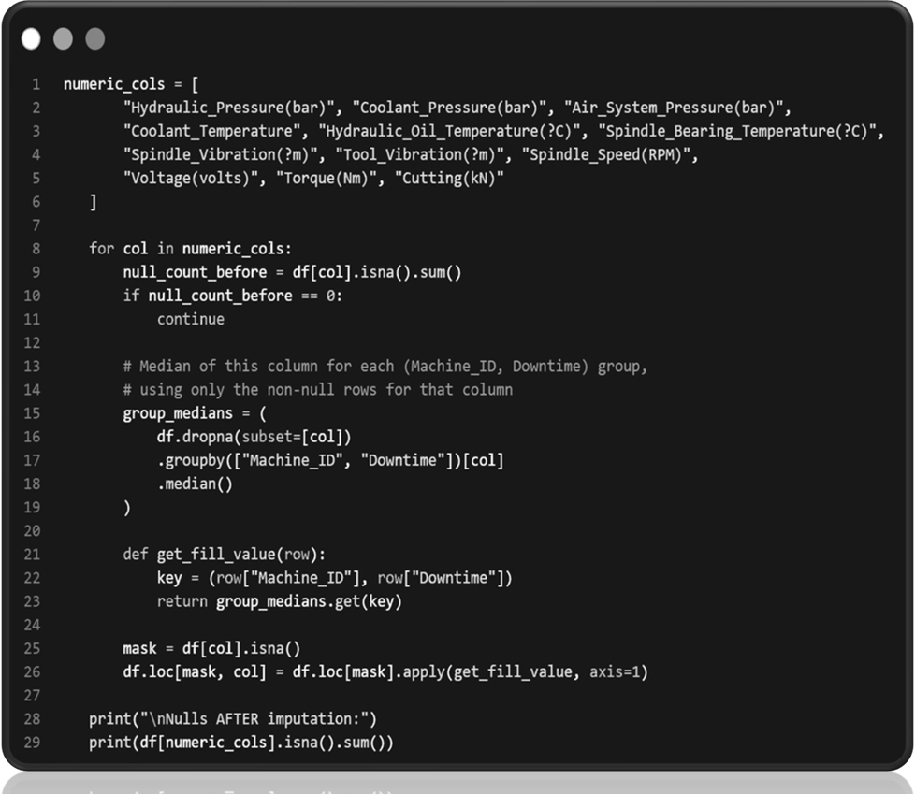
STRATEGIC IMPUTATION METHODOLGY
Group-wise median imputation was applied to numeric columns, with the median calculated based on the simultaneous grouping factors of Machine_ID and Downtime status.
Each missing value filled with the median of its corresponding group
Preserves variation across machines and downtime status

Slide 13
DATA VISUALIZATION

Slide 14
FEATURE ENGINEERING

Slide 15




FEATURE
ENGINEERING
Preparing raw manufacturing data for machine learning models.
Date Column
Removed Date column as it was no longer required for modeling
Encoded target variable (Downtime) into binary format:
Machine Failure → 1
No Machine Failure → 0
Applied One-Hot Encoding on categorical features:
Machine_ID
Assembly_Line_No

Slide 16
TRAIN-TEST SPLIT.
• Separated dataset into Features (X) and Target (y).
→
• Used 80% data for training and 20% for testing.
• Split data into training and testing sets .
→
• Applied stratified splitting to maintain class balance between train and test sets.
→
• Fixed random state used for reproducibility of result.

Slide 17
MACHINE LEARNING MODEL

Slide 18
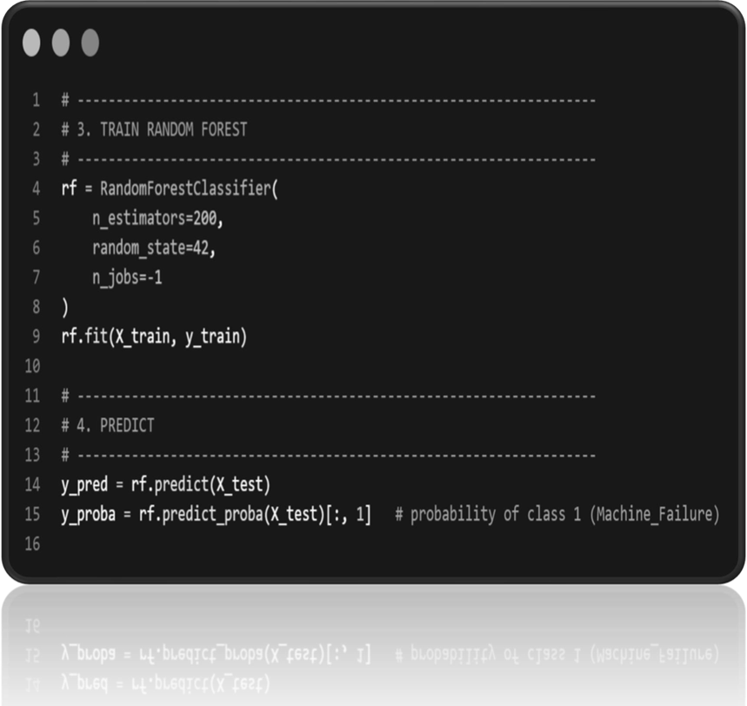
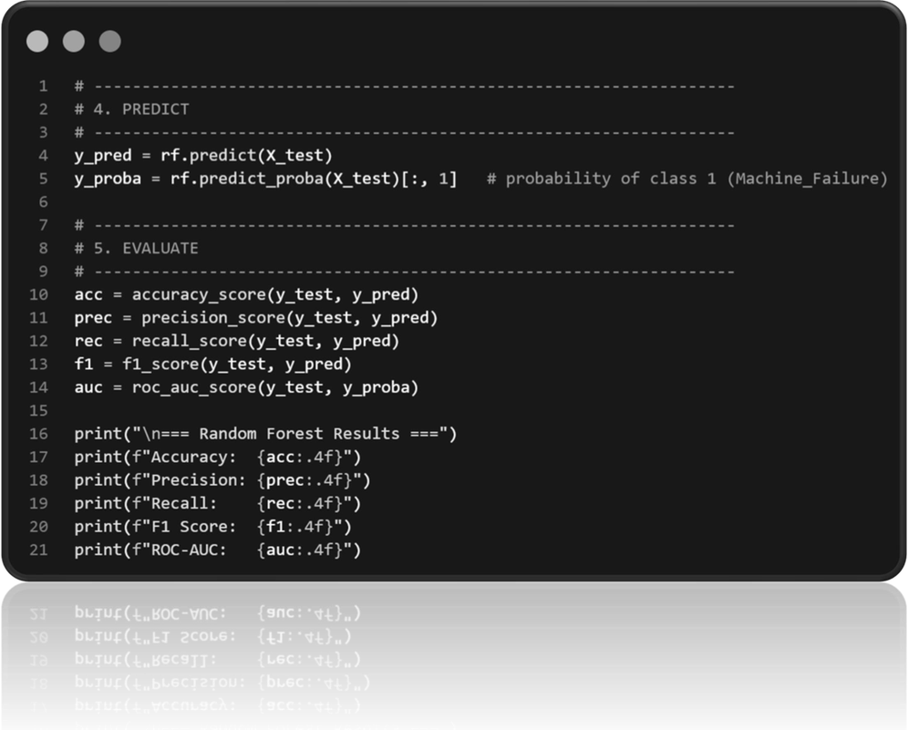
RANDOM FOREST MODEL
Trained a random forest classifier on the training dataset.
Used 200 decision trees (estimators) for building the model.
Fixed random state used for reproducibility of results.
Parallel processing enabled for faster training.
Accuracy → 98.80%
Precision→ 98.05%
Recall→ 99.60%
F1-Score → 98.82%
ROC-AUC→ 99.97%
Model shows excellent and well-balanced performance across all metrics

Slide 19
FEATURE
IMPORTANCE ANALYSIS
Identified top features contributing to model's prediction using Random Forest's feature importance.
Top 4 features dominate the model's decision-making, together accounting for over 84% importance:
⚙️
Torque (Nm)
24.95%
🔧
21.60%
Hydraulic Pressure (bar)
✂️
Cutting Force (kN)
20.83%
💧
Coolant Pressure (bar)
16.74%
Spindle Speed (RPM) also shows moderate importance → 7.96%
Indicates that mechanical and pressure-related parameters are the strongest indicators of machine downtime

Slide 20
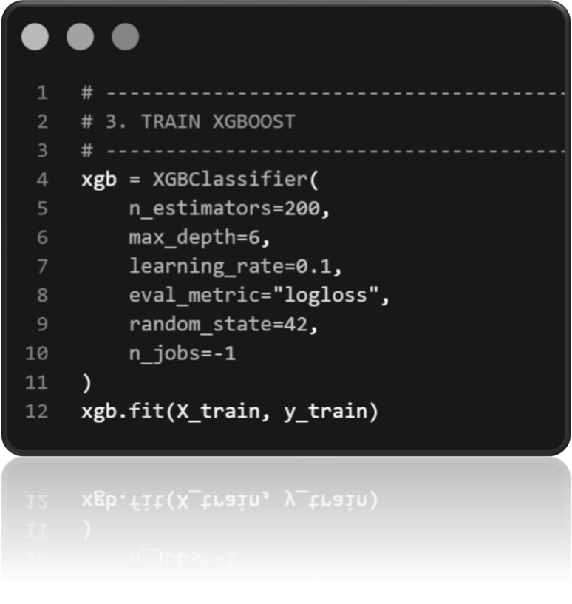
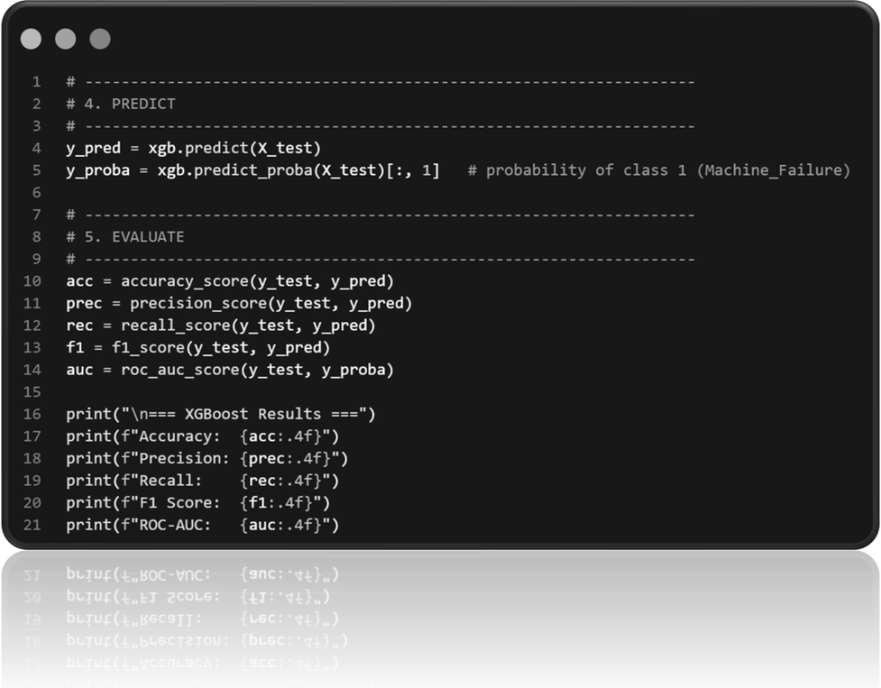
XGBOOST MODEL
Trained an XGBoost Classifier on the training dataset
Used 200 boosting rounds (estimators) Fixed random state used for reproducibility of results.
Maximum tree depth set to 6
Learning rate set to 0.1 for controlled and stable learning
Log loss used as evaluation metric during training
Fixed random state used for reproducibility of results
Accuracy→ 98.80%
Precision→ 98.05%
Recall → 99.60%
F1 Score → 98.82%
ROC-AUC Score → 99.98%
Model shows excellent and well-balanced performance across all metrics

Slide 21
FEATURE
IMPORTANCE ANALYSIS
Identified top features contributing to model’s prediction using XGBoost's feature importance
🔧
Hydraulic Pressure (bar)
44.32%
Dominant Predictor: Hydraulic_Pressure emerges as the primary leading indicator, accounting for 44.32% of the model's decision-making weight.
Secondary Mechanical Drivers: Torque and Cutting_Force follow in significance, contributing 21.40% and 15.16% respectively.

Slide 22
CONCLUSION.

Slide 23
THANK YOU

